Slide 1

Smartphone App for Hair Salon
Team #1: Prem, Connor, Suli, Myles, Grace
Advisor: Professor
Jay Johns

Slide 2

Table of Contents
Team Introduction
Team Lead + Members and roles
Project Sponsor
Project Info
Background Info
Impact
Expected Deliverable
Requirements
Technology
Tech Stack
React
Node.js
Express.js
SQL Server
Git
Other Resources
Other Concerns
Challenges
Success Factors
Development Timeline
Q&A

Slide 3

Meet the Team
Prem Krishna Lavu
Team Lead
Front-end Developer
Connor Springer
Back-End Developer
Suli Alsallal
Back-End Developer
Myles Olagbegi
Front-end Developer
Grace Lueking
Full Stack Developer

Slide 4
Project Sponsor
Big League Barbers
6715 W Jefferson Blvd, Fort Wayne, IN 46804
Contact: Erin Paino (by email)
Advisor: Professor Jay Johns

Slide 5
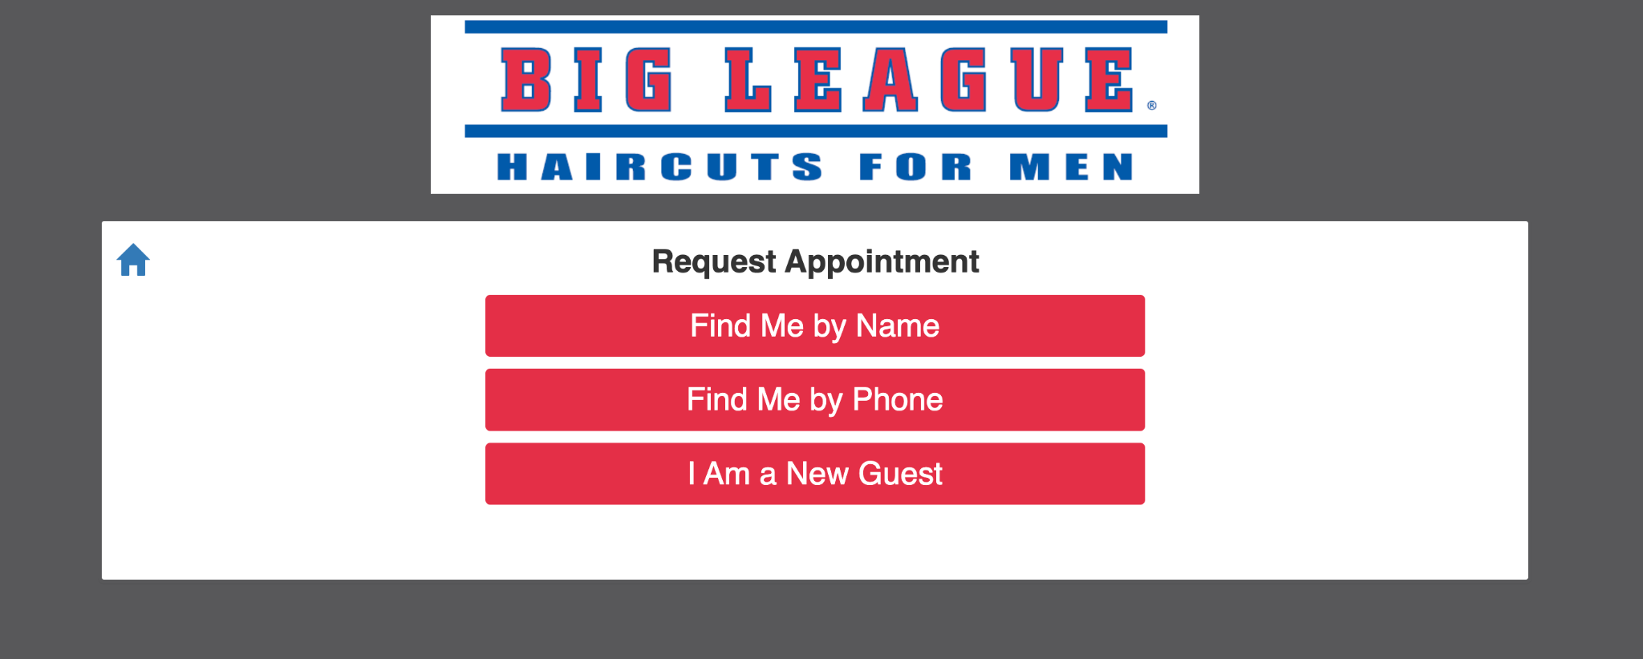
Project Overview
Big League Barbers already has a website for making appointments, describes operating hours, does marketing, and provides contact information and maps to the salon.
Problem
Website is not very user friendly
Name and phone number lookup
Want a mobile version to make it easier and more accessible for clients
Solution
Make the web app more user friendly for clients
Allow clients to schedule appointments on a mobile app
Allow clients to schedule haircut and beard trim

Slide 6

Project Impact
Boost the business’ reach by allowing easier communication between barbers and customers
Improve end-user experience when scheduling appointments with Big League Barbers
Allow the business an opportunity to have an app for their customers to easily schedule appointments

Slide 7
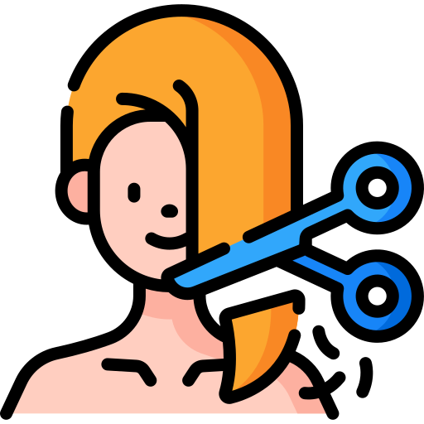

Expected Deliverable
Web App available on Android and IOS
Website does not function great
Web App for easy customer use
Register and login page
Allow customers to Register an account
Appointments under their name & number
Website does not contain Register/Login
Appointment booking for various different haircuts
Haircut
Beard trim

Slide 8

Requirements
Schedule haircuts by themselves and with a beard trim
Have haircut with a beard trim take up two slots
Create User accounts
Store name, email, and phone number
Promote special offers and coupons on the app and through push/email notifications
7th inning stretch system
7th haircut is free
Users get a notification via email and text when they have reached the 7th haircut
Send out reminders for appointment
Who it’s with, type of service, time of appointment
If they don’t request specific stylist, it goes automatically to the next stylist available

Slide 9

Stretch Goals
If an appointment is cancelled, have it show up as cancelled on Big League’s end
Referral codes for users
Give user $2 off their next haircut
Can apply it automatically

Slide 10

Technology Stack
Front-End
React
Back-End
Node.js
Express.js
Database
SQL Server
Node-MSSQL Module
API
GuestVision (Proprietary)
Additional technology to be added or changed as project requires.

Slide 11

Other Resources
Git
Discord
Figma
VSCode
SQL Server Management Studio

Slide 12

What is React?
React is a JavaScript library created by Facebook (now Meta) that’s used to build user interfaces (UIs) for websites and apps
Virtual DOM - makes apps super fast and smooth
In short: A library to build fast, interactive, and modern user interfaces for the web App
Notes:
Grace

Slide 13


What is Node.js/Express.js?
Node.js is a runtime environment that lets you run JavaScript on the server (not just in the browser).
Built on Chrome’s V8 JavaScript engine.
Fast, lightweight, and perfect for handling lots of requests at once.
Without Node.js, your React frontend can’t talk directly to the database (MSSQL).
Node.js acts as the middleman.
Express.js is a framework built on Node.js for building web servers and APIs.
Simplifies tasks like:
Handling routes (/book-appointment, /cancel-appointment).
Processing data sent from the frontend.
Sending responses back to React.
Talking to the database
Think of Node.js as the engine, and Express.js as the steering wheel and controls.
Notes:
Grace

Slide 14


What is SQL Server/MSSQL?
SQL Server (also called MSSQL) is a relational database management system made by Microsoft.
Stores your app’s structured data in tables and columns, and you query it using SQL
We are gonna be using it in our project for:
Users (customers)
Barbers (stylists)
Appointments (who, what haircut, when)
Promotions (Referral codes, coupons)
Node-MSSQL is a module that will allow Node.js to interact with the SQL database
Most of the interaction with the app-specific database will be performed using this
Notes:
Grace

Slide 15

Challenges
Interaction with GuestVision
In order to manage appointment scheduling; we will need to find out how to send requests to GuestVision’s API.
We may also get in contact with the current website’s developer to figure out how to form requests to Guestvision’s API.
Interaction with Website Developers
An IT capstone team is creating a website for Big League Barbers; we will need to contact said team to ensure smooth interaction between the site and the application.
Potential roadblocks for specific features
A number of the optional features rely on our ability to use the GuestVision API to implement them.

Slide 16

Success Factors
Meeting sprint goals consistently
Proper project management
Effective communication
Team member diligence

Slide 17

Development Timeline
Week 1 (Sept 20 – Sept 26)
Planning & Setup
Week 2 (Sept 27 – Oct 3)
UI/UX Design & Database Build
Week 3 (Oct 4 – Oct 10)
Core Screens – Part 1
Week 4 (Oct 11 – Oct 17)
Appointments Feature – Part 1
Week 5 (Oct 18 – Oct 24)
Appointments Feature – Part 2
Week 6 (Oct 25 – Oct 31)
Reminders & Notifications
Week 7 (Nov 1 – Nov 7)
Rewards & Referrals
Week 8 (Nov 8 – Nov 14)
Stylist & Admin Features
Week 9 (Nov 15 – Nov 21)
Polish & Integration
Week 10 (Nov 22 – Nov 26)
Sponsor Feedback & Iteration
Week 11 (Nov 27 – Nov 30)
Final Testing & Presentation Prep

Slide 18
Thank You
Questions?

